Slide 1
Systems Thinking And The Inner Game Of Leadership
“Vision without systems thinking
ends up painting lovely pictures of
the future with no deep understanding of the forces that must be mastered
to move from here to there”.
— Peter Senge
"We can't impose our will on a system. We can listen to what the system tells us and discover how its properties and our values can work together to bring forth something much better than could ever be produced by our will alone”.
— Donella H. Meadows
“
“Most people are doing a second job no one is paying them for...Most people are spending time
and energy covering up their weaknesses, managing other people’s impressions of them, showing themselves to their best advantage, playing politics, hiding their inadequacies, hiding their uncertainties, hiding their limitations”. - Prof. Robert Kegan
“It is amazing how often you come across teams with an average IQ of over 120, but the team functions with a collective IQ of about 60”.
- Peter Senge
baz.hartnell@vucaleadership.co.uk www.vucaleadership.co.uk

Slide 2


Our Agenda
Systems Thinking
Dialogical Thinking
"Systems thinking is a discipline for seeing wholes. It is a framework for seeing interrelationships rather than things, for seeing 'patterns of change' rather than 'static snapshots.’” — Peter Senge
"Dialogue is about a shared inquiry, a way of thinking and reflecting together. It’s not something you do to another person. It is something you do with people.“ — William Isaacs
"The thing that mostly gets in the way of
dialogue is holding to assumptions and
opinions and defending them."— David Bohm
“The problems in the world stem from the difference between how we think and
how the world works”. - Gregory Bateson
Leader Inner-Game Development
Systems Leadership
"For some people, systems thinking is the application
of a series of tools....approaches, methodologies, techniques, but to me, those tools tend to really just serve to be more sophisticated forms of mechanistic thinking if you haven't shifted into a systems thinking mindset; systems thinking is a way of being... a way
of seeing the world, as an attitude of mind”.
- Martin Sandbrook
=
"Systems Leadership is how you lead when
you’re not in charge." — Debbie Sorkin
“Leadership in the volatile, uncertain, complex and
ambiguous (VUCA) environment in which we live,
is essentially shaping a desirable future (in the present) in collaboration with parties of diverse perspectives”. - Sandra Martínez, John Agoglia

Slide 3




The VUCA World And It’s Leadership Illusions
“Doubt is an uncomfortable condition, but certainly is a ridiculous one”. - Voltaire
Volatility
Uncertainty
Complexity
Ambiguity
The speed, volume, magnitude and
dynamics of change
The lack of expectedness of issues and events creates anxiety within us
The compounding of issues and the high levels of interdependencies
The haziness of reality; varied interpretations across situations
Illusion of PERMANENCE
Work and life is more fragile and unstable than we think. We are unable to keep up with the rapid changes taking place.
Illusion of CONTROL
People want control to minimise their anxiety and to feel safe, but surprises abound in
a VUCA landscape.
Illusion of PREDICTABILITY
There are too many interconnected parts interacting without
any clear causality.
Illusion of KNOWLEDGE
we cannot ‘know’ our way out of VUCA and anyhow, some situations are beyond meaningful interpretation.

Slide 4
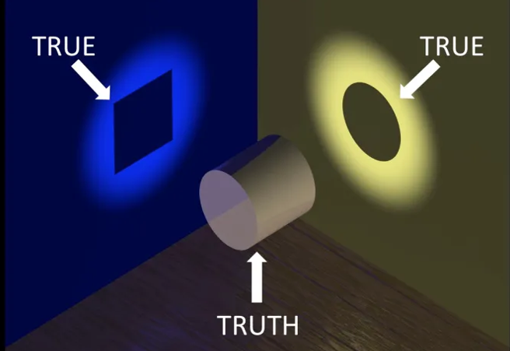
VUCA’s Ambiguity
“Two people who see the same picture differently may actually,
in their seeing of it, be creating two different pictures”.
- Jenifer Garvey Berger
“Everything we hear is an opinion, not a fact. Everything we see is
a perspective, not the truth”.
― Marcus Aurelius
“Some problems are so complex that you have to be highly intelligent and well informed just to be undecided about them”. - Laurence J. Peter
“We have to access our ignorance”.
- Edgar Schein
“If you’re not confused, then you’re not paying attention”. ― Kim S. Cameron
“Do I enjoy the pleasant surprise of discovering I’m mistaken?”
– Warren Burger

Slide 5
The Cynefin
Framework
Unpredictability / Instability
Predictability / Stability
Complex / Wicked
The relationship between cause and effect can only
be perceived in retrospect.
Complicated
The relationship between cause and effect requires analysis or investigation and/or application of expert knowledge.
“The Cynefin framework is a conceptual framework used to aid decision-making. Cynefin is
a Welsh word meaning 'habitat', 'acquainted', 'familiar’.”
  - Wikipedia
Disorder
Chaotic
There is no relationship between cause and
effect at the systems level.
Simple
The relationship between cause and effect is
obvious to all.
“The most common source
of failure in leadership is a diagnostic failure. People
treat adaptive [complex / wicked] challenges as if
they were technical [complicated] problems.”
- Ronald Heifetz
Source: Prof. Dave Snowden and Mary Boone

Slide 6
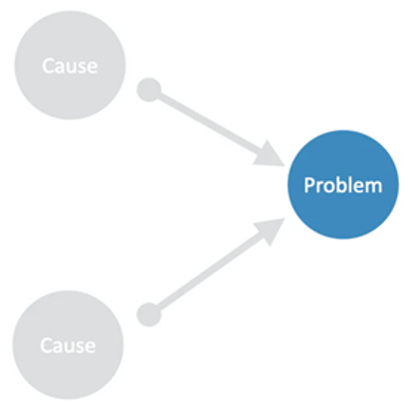
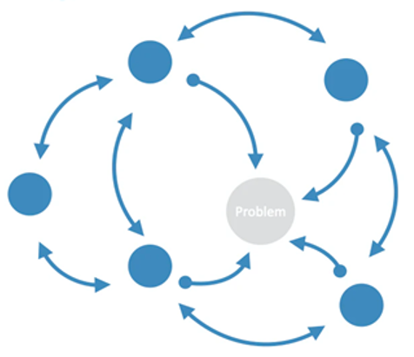
Complicated
Vs. Complex Problem Solving
Linear Analytical Approach
For Simple / Complicated Problems
Identify the “problem”, find the
immediate causes of that issue and
change the causes to “solve” the problem
“We act as if simple cause and effect
is at work. We push to find the one simple reason things have gone wrong. We look for the one action
or the one person that created this
mess. As soon as we find someone to
blame, we act as if we've solved the problem”. - Margaret Wheatley
Non-linear Synthesist Approach
For Complex Challenges
Identify the system, see how the set of surrounding factors interrelate to create the emergence of the issue. Influence the thinking, connections and parts to change the system’s dynamics and “dissolve” the problem
“We’re thinking about systems change not as an issue or a person that needs to be fixed… it’s the set of conditions that surround that individual. We need to work on dissolving the conditions that hold the problem in place”. - John Kania

Slide 7




Am I leading from "knowing" or "not knowing“ when addressing complex problems? Am I using my authority to provide the answer (which is counterproductive in complexity), or am I using my authority to host the right questions and ensure the collective intelligence of the room is maximised?
Self-Reflection Exercise
The Leadership Of Complex / Wicked Problems
What heroic myths am I reinforcing? Am I unconsciously signalling that I am the "Decisive Commander" or the "All-Knowing Expert"? How does that posture prevent my team from bringing forward constructive dissent or bad news?
What am I attached to? Do I need my initial solution to be the right one, or can I truly practice "An Open Mind" and allow the solution to emerge from the system? What is the personal cost to me of giving up the illusion of control?
“Thoughtful reflection on natural experience, in light of conceptual models is one of the most powerful tools we have for management learning.”
- Henry Mintzbergg

Slide 8

Diagnosing Complex / Wicked Problems
“For every complex problem there is an answer that is clear, simple and wrong”. - Henry Mencken
2. Wicked problems
are interconnected with each other
3. They’re often symptoms of deeper wicked problems
4. They cannot be disentangled from
their context
1. Lack of clarity in defining the problem
5. They operate across team or organisational boundaries or wider
6. Contain multiple stakeholders with conflicting agendas
7. They are subjective, rooted in attitudes, values and beliefs
8. People experience loss, disorientation and stress, so resist or avoid
9. No single entity has
the authority to
impose a solution
10. People are both part of the problem and are also part of the solution
11. ‘Solutions’ are
better or worse rather
than right or wrong
12. All interventions
are experimental
and irreversible
14. Requires new ‘leader capacities’ and adaptation, so ‘experts’ are of limited value
16. Not resolvable by analytical thinking, nor by evidenced based, nor solved intellectually
13. Non-linear in terms
of cause and effect; unintended consequences
15. Persistent/intractable
re-solution vs resolution
Managing ‘polarities’

Slide 9
Self-Reflection Exercise
Identifying Wicked Problems
How wicked are the problems and leaderships challenges you face…how many of the 16 characteristics apply to some of the issues you are wrestling with?
How might a leader who believed that all situations could be controlled, predicted and fully known about in a VUCA environment behave, compared to a leader who realises they cannot?
“Thoughtful reflection on natural experience, in light of conceptual models is one of the most powerful tools we have for management learning.”
- Henry Mintzbergg

Slide 10

Systems Thinking
“Systems thinking means the ability to see
the synergy of the whole rather than just a separate elements of a system and to learn to reinforce or change whole system patterns”. – Richard Daft
“No problem stays solved in a dynamic environment”. - Russell Ackoff
“This may sound simple, but transformational change requires true transformational intent. Real, hold on to
your hats, reconfigurations of service offerings and entire business models, holding difficult conversations with stakeholders
and losing some along the way”.
- Kate Wolfenden

Slide 11

Five Ways To Think About Systems
Linear
Non-Linear
Collaborative
Complex / VUCA
Meta
Change is
Simple and Linear
Change is
Complicated
Change is
Collaborative
Change
Emerges
Change is
Relational
I can step outside
of the organisation, diagnose what’s wrong, plot an intervention, then step back inside.
I can control change.
People do as they are told or as they are persuaded to do – unless they are ‘resistant to change’.
I can step outside the organisation, diagnose what’s wrong, plot an intervention, then step back inside.
I can control change.
People do as they are told or as they are persuaded to do – unless they are ‘resistant to change’.
I need to be smarter by gaining knowledge and expertise.
We can step outside the organisation, diagnose what’s wrong, plot an intervention, then step back inside.
We can control change.
People do as they are told or as they are persuaded to do – unless they are ‘resistant to change’.
We need to be smarter.
We need to be collaborative.
We cannot step outside the system…we are always part of the system.
I cannot control change, but I do influence it.
Everyone influences change and change emerges.
Every conversation we have contributes to the emergence of change.
I need to engage.
I need to be self-aware.
Organisations are not systems.
Boundaries are socially constructed
Change emerges from relationships.
Conflict is essential.
I need to think about how I think.
Source: Dr. Paul Lawrence, Coaching Systemically

Slide 12
Self-Reflection Exercise
Beliefs About
Systems Thinking
In your own mental models of how you perceive the world works or how change happens, which of the statements in the last two columns are well developed within you and which are not yet fully owned by you?
“Thoughtful reflection on natural experience, in light of conceptual models is one of the most powerful tools we have for management learning.”
- Henry Mintzbergg

Slide 13
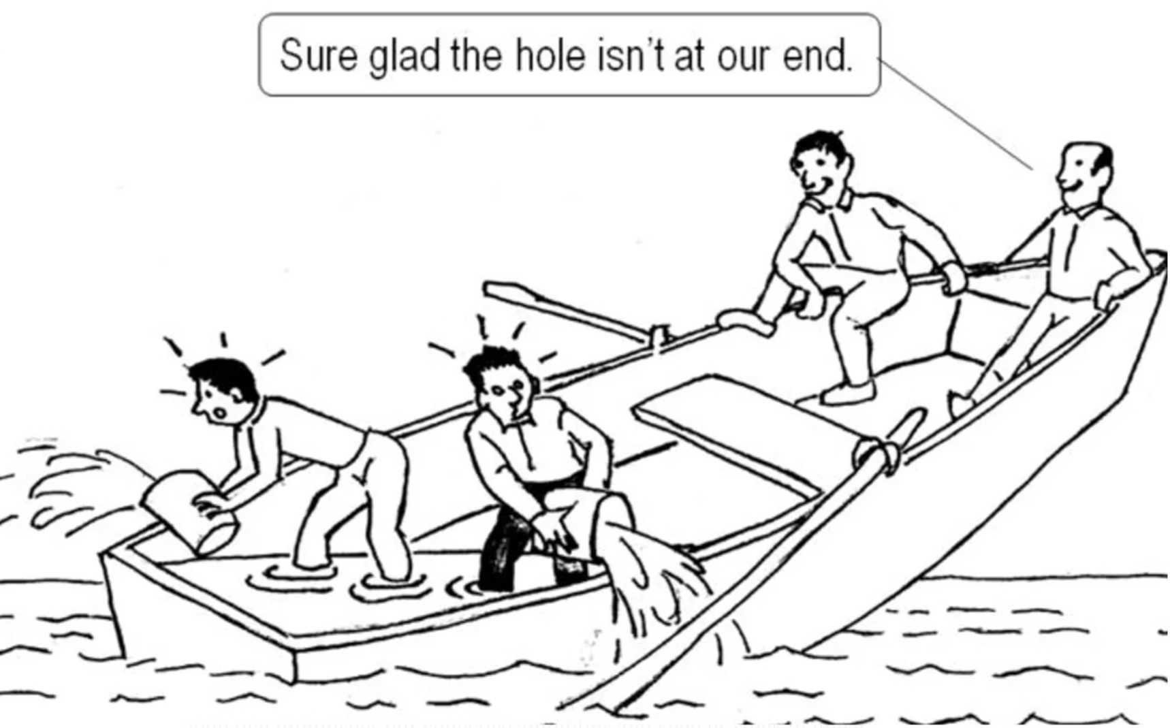
System Blindness
“System blindness is everywhere …and the most dangerous thing about blindness is that when we’re blind, we don’t know we’re blind. We think we see. We take what we see as the truth and we act.”
- Barry Oshry
"We make up stories about situations; we take it personally, as if we were aimed to deliberately challenge or hurt us; we react to it by getting mad, even or withdrawing …and that is the end of the relationship!”
- Barry Oshry

Slide 14
Systems Thinking - ‘Mind Opening Questions’ / Thought Forms
Context: requires leaders to understand that issues are not isolated, but are shaped by the larger surrounding system—the culture, rules, history and power dynamics—that holds issues in place.
Process: focuses on how things change over time, forcing leaders to look beyond static problems to identify the dynamic pattern and feedback loops that sustain the system's current behaviour.
“The problems in the world stem from the difference between how we think and how the world works”.
- Gregory Bateson
Relationship: compels leaders to see that the system's performance
is not the sum of its individual parts, but the product of their interaction, which often generates new properties (emergent properties) that can't be found by studying the parts alone.
“The world is made of circles and we think in straight lines”. ― Peter Senge
“Without an appropriate match between the complexity of our thinking and the complexity of the world, leaders in government and in business will fail to meet the complex challenges that face them every day in their work”.
- John Stewart
Transformation: challenges leaders to recognise that meaningful, lasting change is not a quick fix, but an evolution in the system's underlying mindset or structure, which requires a fundamental
shift in how the organisation perceives and responds to reality.
Source: De Visch, Jan; Laske, Otto. Practices of Dynamic Collaboration

Slide 15
Context, Process, Relationship & Transformation Mind Opening Questions
What is the larger system or environment in which this issue is embedded?
What are the prevailing assumptions, values or norms that shape our understanding of this issue?
Who are the different stakeholders involved and what are their perspectives or interests?
What are the elements (e.g. rules, resources, power dynamics) that define the context?
How has this issue / phenomenon changed or developed over time?
What are the patterns of change (e.g. cyclical, linear, emergent…)?
How do different elements interact to produce change?
What are the feedback loops that sustain or alter the processes playing out?
C
P
What are the key components or elements involved and how are they connected?
How do these relationships contribute to the overall functioning or character of the whole?
Are there any tensions, conflicts or contradictions in these relationships?
What new properties emerge from these relationships that are not present in the individual parts?
What new possibilities or perspectives emerge when we look at this differently?
What are the conditions necessary for a qualitative leap or transformation to occur?
What assumptions need to be challenged or overturned for transformation to happen?
How can apparent opposites be integrated into a more comprehensive whole?
R
T

Slide 16
Think of a Wicked/Complex issue that you are currently facing and reflect on the following questions:
Context: What assumptions do you bring to your issue?
Process: How do your habitual patterns of thinking / acting reinforce the issue?
Relationship: How do your interactions / relationships help or hinder systemic solutions?
Transformation: How might you need to grow or change to show up more effectively to move the issue forward?
Self-Reflection Exercise
Mind Opening Questions
“Thoughtful reflection on natural experience, in light of conceptual models is one of the most powerful tools we have for management learning.”
- Henry Mintzbergg
Individually, rank which thought forms feel “natural” to you and which feels least comfortable. Reflect on how that blind spot has shown up in your leadership.

Slide 17
Patterns Of Thinking Re: Systems Thinking
Bias | Obstruction to Systems Thinking | Inner Game Requirement
Confirmation Bias | Blocks the Context and Relationship. We seek evidence that confirms our existing mental model, ignoring feedback loops or contradictory data from the wider system. | Humility & Inquiry: Willingness to "get your model shot at" (Meadows) and prioritise learning over being right.
2. Fundamental Attribution Error | Blocks the correct analysis of Causality. We attribute other people’s negative actions to their character (internal flaw) and ignore the system or context (external forces) that caused the behaviour. | Compassion & Structure: Ability to look past the individual to the processes and incentives that shape behaviour.
3. Availability Heuristic | Blocks the understanding of Process. We rely too heavily on the most recent, vivid, or easily recalled information (the static snapshot) rather than searching for long-term patterns or subtle, delayed feedback loops. | Patience & Data: Discipline to gather and analyse long-term, non-obvious data to reveal the true dynamic patterns of change.
4. Action Bias (or Illusion of Control) | Blocks effective Intervention. Driven by the inner need for control and the fear of being seen as idle, we rush to implement an immediate, visible "fix," even when observation and patience would be a superior action. | Presence & Restraint: The capacity to pause, accept uncertainty and listen to the system before making a minor intervention at a high-leverage point

Slide 18
Comparing Debate and Dialogue
Debate …winning is the goal
Dialogue ...finding common ground
Debate is oppositional: two sides oppose each other
and attempt to prove each other wrong
Dialogue is collaborative: two or more sides work together toward common understanding
Debate assumes that there is a right answer
and that someone has it (‘either / or’ thinking)
Dialogue works to uncover confusion, contradictions and paradoxes with an aim to deepen understanding
One submits one’s best thinking and defends
it against challenge to show that it is right
In dialogue, one submits one’s best thinking, knowing that other peoples’ reflections will help improve it
Debate defends assumptions as fact. Debate
defends one’s own positions as the best solution
Dialogue calls for temporarily suspending judgments
One listens for flaws and weaknesses in the other position
One listens for strengths in the other positions
Debate involves a countering of the other position
and often belittles the other person.
In dialogue, emotions help deepen understanding of personal, group and intergroup relationship issues

Slide 19
Self-Reflection Exercise
To what extent do you find yourselves involved in debates rather than dialogues, whilst exploring wicked problems? Why might that be?
Dialogues And Dissent
What’s your relationship to confrontation? How might you embrace within discussions the conflict and dissent?
“Thoughtful reflection on natural experience, in light of conceptual models is one of the most powerful tools we have for management learning.”
- Henry Mintzbergg

Slide 20
Leadership Learning Versus Leader Development
 | Traditional Learning (The 'What' and 'How') | Leader Development (The ‘Who')
The Goal | Competency. To add new skills, knowledge and tools to the leader’s existing repertoire. | Capacity. To fundamentally change the leader’s mind, allowing them to make sense of greater complexity.
The Analogy | Adding Apps to your Phone. You learn a new skill e.g. systems thinking, strategy development or change management. | Upgrading the Operating System You shift your entire worldview, becoming more adaptable and able to run more powerful, complex "apps."
Impact On Leader | Broadening. You become more skillful at what you already do. | Deepening / Elevating. You become more effective and wiser in everything you do by handling greater complexity, paradox and ambiguity and make sense more holistically .
Typical Methods | Training workshops, certifications, technical courses, on-the-job training in a new function. | Challenging assignments ("Heat Experiences"), reflection/coaching, being and forced to re-solve genuinely ‘Colliding Perspectives’ or ‘Disorientating Dilemmas’.

Slide 21
The ‘Who’ Of Leadership
A mental model is an explanation of someone’s representation about how something works in the real world. It’s an internal map of how we construct and represent the world from our past experiences and conditioning.
“We don't see things as they are, we see them as we are”.
— Anaïs Nin
Mental Models
Representations of how we subjectively understand, mediate and filter our experience of reality into patterns of thoughts, feelings
and actions, which both shape and limit our interpretations of present events and expectations of future ones
Working Models
Identity
Begin challenging your own assumptions. Your assumptions are your windows on the world. Scrub them off every once in a while, or the light won't come in”.
- Alan Alda
The sense we have of being a separate “I” or “ego”
A ”me” in relation to all we perceive to be “not me”
Who we take ourselves to be (our identity)
Experiences and relationships we are ‘I-dentified’ with
Sources: Adapted from Attachment in Psychotherapy; David J Wallin

Slide 22
Hero
To
And
Host
Leadership flows from a ‘leader’ towards
a group of ‘followers’ to modify their behaviour to reach a set of goals or vision
Leadership is a distributed process in which everyone is involved in making sense of and deciding our direction and building alignment
Commander and Controller
Convenor and Facilitator
Sole owner of problem and solution
Prime mover; co-own problem and solution
Having all the answers / Individual expertise
Creates conditions where answers ‘emerge’ / mobilising the experience & ideas of others
A single intelligence
Distiller of collective intelligence / meaning
“How do I take charge and
make things happen”?
“How do I participate in an
effective process of leadership”?
Source: Adapted from Peggy Dulany, Wilfred Drath, Charles Palus

Slide 23
Developing Our Working Models
Heroic Leaders Mindset
Host leaders Mindset
‘out in front’ / knowing / decisive
facilitating dialogue between stakeholders and their constituencies
leaders should have the answers
(and the ‘right’ answer is out there)
given VUCA, its OK not to know the
answer and there is no ‘right’ answer
“It has become almost a cliché among leadership theorists to disavow a heroic command-and-control model of leadership. But the heroic image of leadership that prevails in the conventional mind is more than a model. It is a deep and abiding myth.”
- Sharon Parks, 2005
directing the activities of others; demonstrating “being in charge”
creating a “holding environment”
for new possibilities to emerge
single-handedly able to transform
and improve the organisation
building a common sense of direction, alignment and commitment
between multiple stakeholders
able to see the vision with such clarity that even the steps to achieve the vision are visible to them
cognisant they only have a partial view of reality and need the views of others
able to get people to “understand” and accept their view through persuasion
Creating a learning / growth mindset
by ensuring an equality of
influence across all stakeholders

Slide 24
Self-Reflection Exercise
Working Models
To what extent currently is your working model more that of a hero, a host… or are both perspectives well developed?
How might you more fully embrace the mindset of a host? What might get in your way to achieve that?
“Thoughtful reflection on natural experience, in light of conceptual models is one of the most powerful tools we have for management learning.”
- Henry Mintzbergg

Slide 25
Growing Up Our Working Models From ‘Ego’ to ‘Ethno’ to ‘Eco Centric’
“Self-interest is for the past. Common interest is for the future.”- Sir David Attenborough
“Great leaders truly care about those they are privileged to lead and understand that the true cost of the leadership privilege comes at the expense of self-interest”. - Simon Sinek
Ego-Centric
Ethno-Centric
Eco-Centric
A desire to be in service to just oneself...prioritising what's in it for me (WIIFM)?
“I versus others”.
A preference to be in service to my team, department, division, organisation...putting my ‘group’ before others.
“Us versus them”.
The preference to be in service to all rather than oneself, even if it comes at a personal cost.
“All of Us”

Slide 26

Cleaning Up
“Successfully functioning in a society with diverse values, traditions and lifestyles requires us to have a relationship to our own reactions, rather than be captive of them.”
– Prof. Robert Kegan
“Until you make the unconscious conscious, it will rule your life and you will call it fate”.
- Carl Jung
“We have to make our fears our agenda”.
James Hollis

Slide 27
Making Our Fears Our Agenda
“Do you wish to rise? Begin by descending. If you plan a tower that will pierce the clouds, then lay first the foundation of humility”. - St Augustine
‘Complying’ in Leadership
- Fear of Rejection
‘Protecting’ in Leadership
- Fear of Vulnerability
‘Controlling’ in Leadership
- Fear of Failure
security by complying with
other’s expectations
protection through withdrawing, hiding and being cynical
personal worth through task accomplishment and achievement
Pleasing
Distant
Autocratic
to seek others’ support and
approval in order to feel secure
to abdicate, be aloof
and emotionally distant
to be forceful, aggressive
and controlling
Belonging
Critical
Manipulative
to conform, follow the rules, and meet the expectations of those in authority
to take a critical, overly rational
and somewhat cynical attitude
by using charm or stretching
the truth to get their own way
Passive / Avoid Conflict
Arrogant
Perfectionist
gives away power to others and to circumstances outside their control
to project a large ego – behaviour that is experienced as superior & egotistical
to attain flawless results and
perform to extremely high standards
Source: Karen Horney and adapted from Anderson, R. & Adams, W. (Mastering Leadership 2016)

Slide 28
Summary Of Unconscious Fear Induced Commitments
Fear Of… | Unconscious Commitments
Rejection (Please-aholic) | I am committed to being liked and accepted by my colleagues. I am committed to avoiding any form of professional rejection or criticism. I am committed to maintaining harmonious relationships at all costs. I am committed to protecting myself from feeling isolated or unpopular.
Vulnerability (Right-aholic) | I am committed to maintaining an image of unwavering strength and self-sufficiency. I am committed to avoiding any perception of weakness or incompetence. I am committed to protecting my authority and professional standing by being right. I am committed to preventing others from taking advantage of my perceived weaknesses.
Failure (Work-aholic) | I am committed to avoiding any form of failure or significant error. I am committed to maintaining a flawless track record and perfect image. I am committed to mitigating all potential risks, even at the expense of progress. I am committed to protecting myself from blame or negative scrutiny.
Source: ‘Immunity To Change’ - Prof. Robert Kegan and Linda Laskow Lahey

Slide 29
Self-Reflection Exercise
What fears and unconscious commitments can you recognise in yourself?
Our Fears And Their Unconscious Commitments
What fears and unconscious commitments can you recognise in others?
“Thoughtful reflection on natural experience, in light of conceptual models is one of the most powerful tools we have for management learning.”
- Henry Mintzbergg
How might you experiment in an upcoming meeting to face into one of your unconscious commitments ?

Slide 30
Wisdom
“Wisdom is having expert knowledge in the fundamental pragmatics of life that permits exceptional insight, judgment and advice about complex and uncertain matters”. – Paul Baltes
A capacity to discern what’s possible & what’s not; awake to illusions
Possessing a humility to be aware of one’s arrogance and judgements
Showing Up as a Humble Host
- An ‘authentic self’ perspective
Compassion (with self and others)
Latin root of the word compassion means “to suffer with”.
Meeting people with “unconditional positive regard”
Self-compassion: Recognising ourselves as flawed, yet still able to hold ourselves in high regard (more than taming our inner critics)
“The ability to behave with wisdom and compassion, while maintaining inner and outer peace (equanimity) regardless of the situation”.
- Cindy Wigglesworth
Equanimity
Presence – letting go of outcomes; passionate detachment
An acceptance / ambivalence of “what is, is”.
Ambivalence in being a disappointment; it’s a learning opportunity.
Rudyard Kipling’s poem “If” epitomises equanimity.

Slide 31

www.vucaleadership.co.uk
A Free Self-Paced Online Course:
“Leading In A VUCA World”
baz.hartnell@vucaleadership.co.uk

