Slide 1
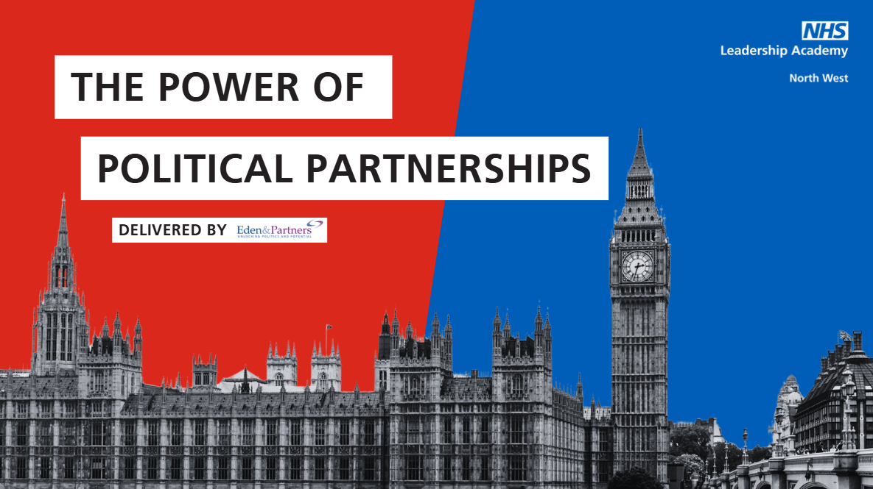

Slide 2
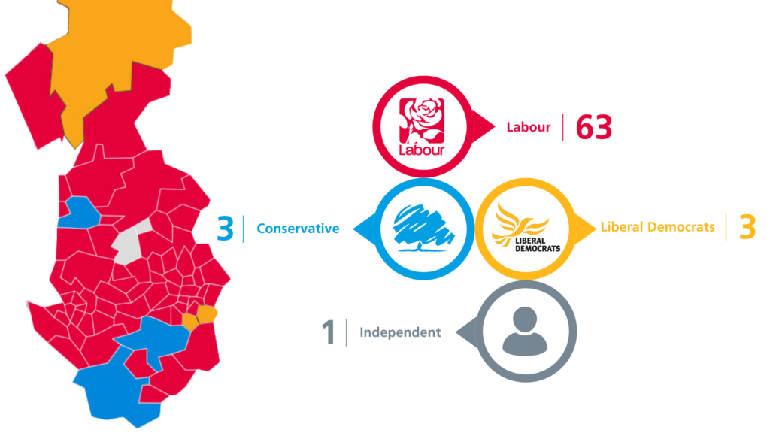

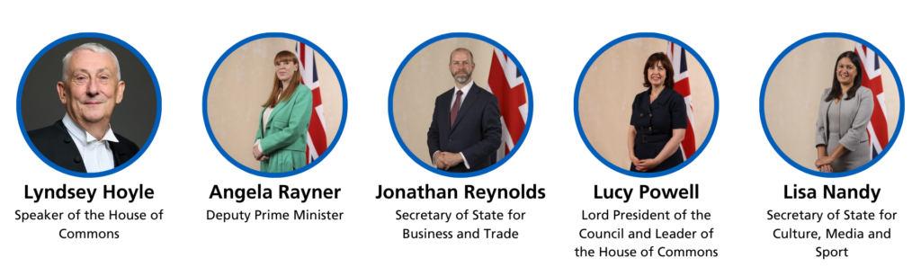



Slide 3
The North West Picture
 | 2015 | 2019 | 2024
Labour | 51 | 41 | 63
Conservative | 22 | 32 | 3
Liberal Democrat | 2 | 1 | 3

Slide 4





The UK Parliament 2024 Intake
More than half are first-time MPs​
Women now account for over 40% of MPs​
14% of MPs are from ethnic minority backgrounds (UK 18% at 2021 Census)
Only 1 Cabinet member educated privately​
55% of MPs attended Oxbridge or Russell Group universities​
48
Average MP age has dropped from 50 to 48​
+%
30
There are 20 MPs under age 30

Slide 5
Table Conversation 1
  What are our experiences of working with existing and new MPs locally?​
  What has changed since the general election? ​
  How is this changing the way we work with the current group of MPs, individually and on a wider geographic footprint?

Slide 6
Discussion Summary
High levels of engagement with devolved or senior politicians doesn’t have to create tension with local MPs. The key is to connect at all levels and maintain open, inclusive relationships.
NHS organisations with pan-regional footprints can move beyond reactive engagement by simply reaching out and introducing their work to MPs. This helps build trust over time.
There are lots of politicians with influence, so engagement should be broad and strategic. While much NHS-government interaction focuses on funding and operational matters, we also have the opportunity to influence long-term policy, including shaping the next election manifesto for the NHS. Meeting with political leaders at all levels is crucial to making this impact.

Slide 7
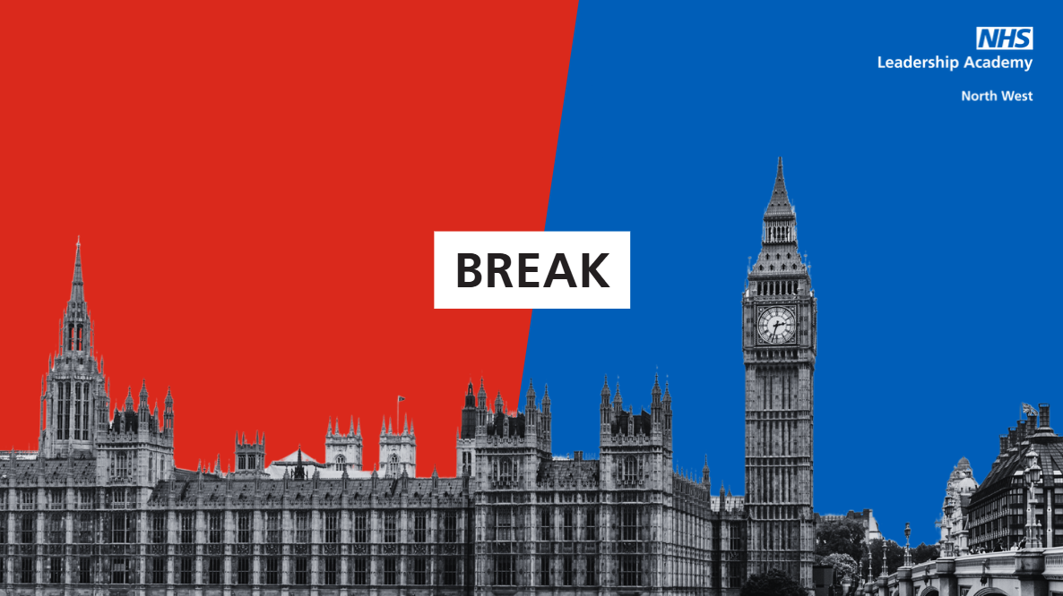

Slide 8
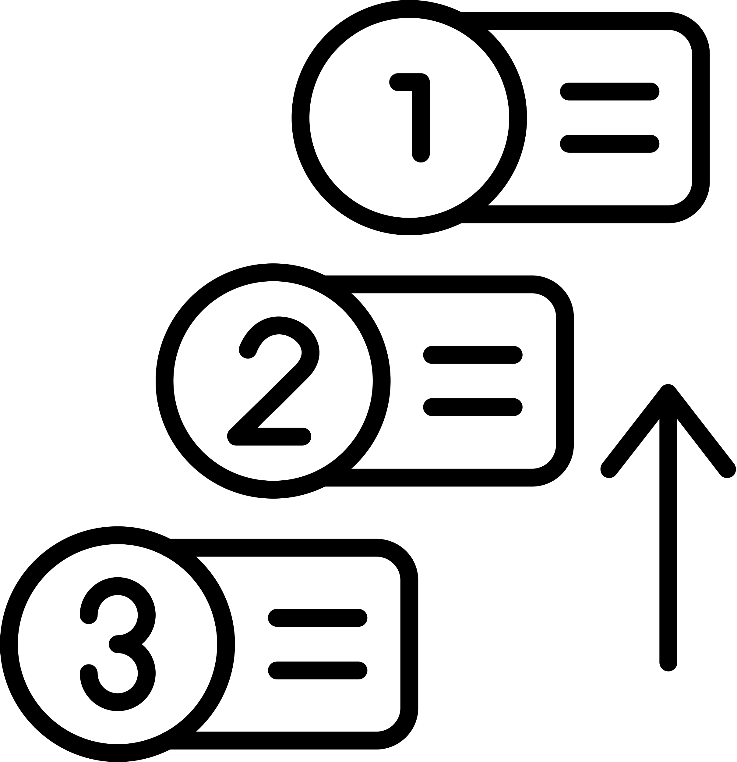
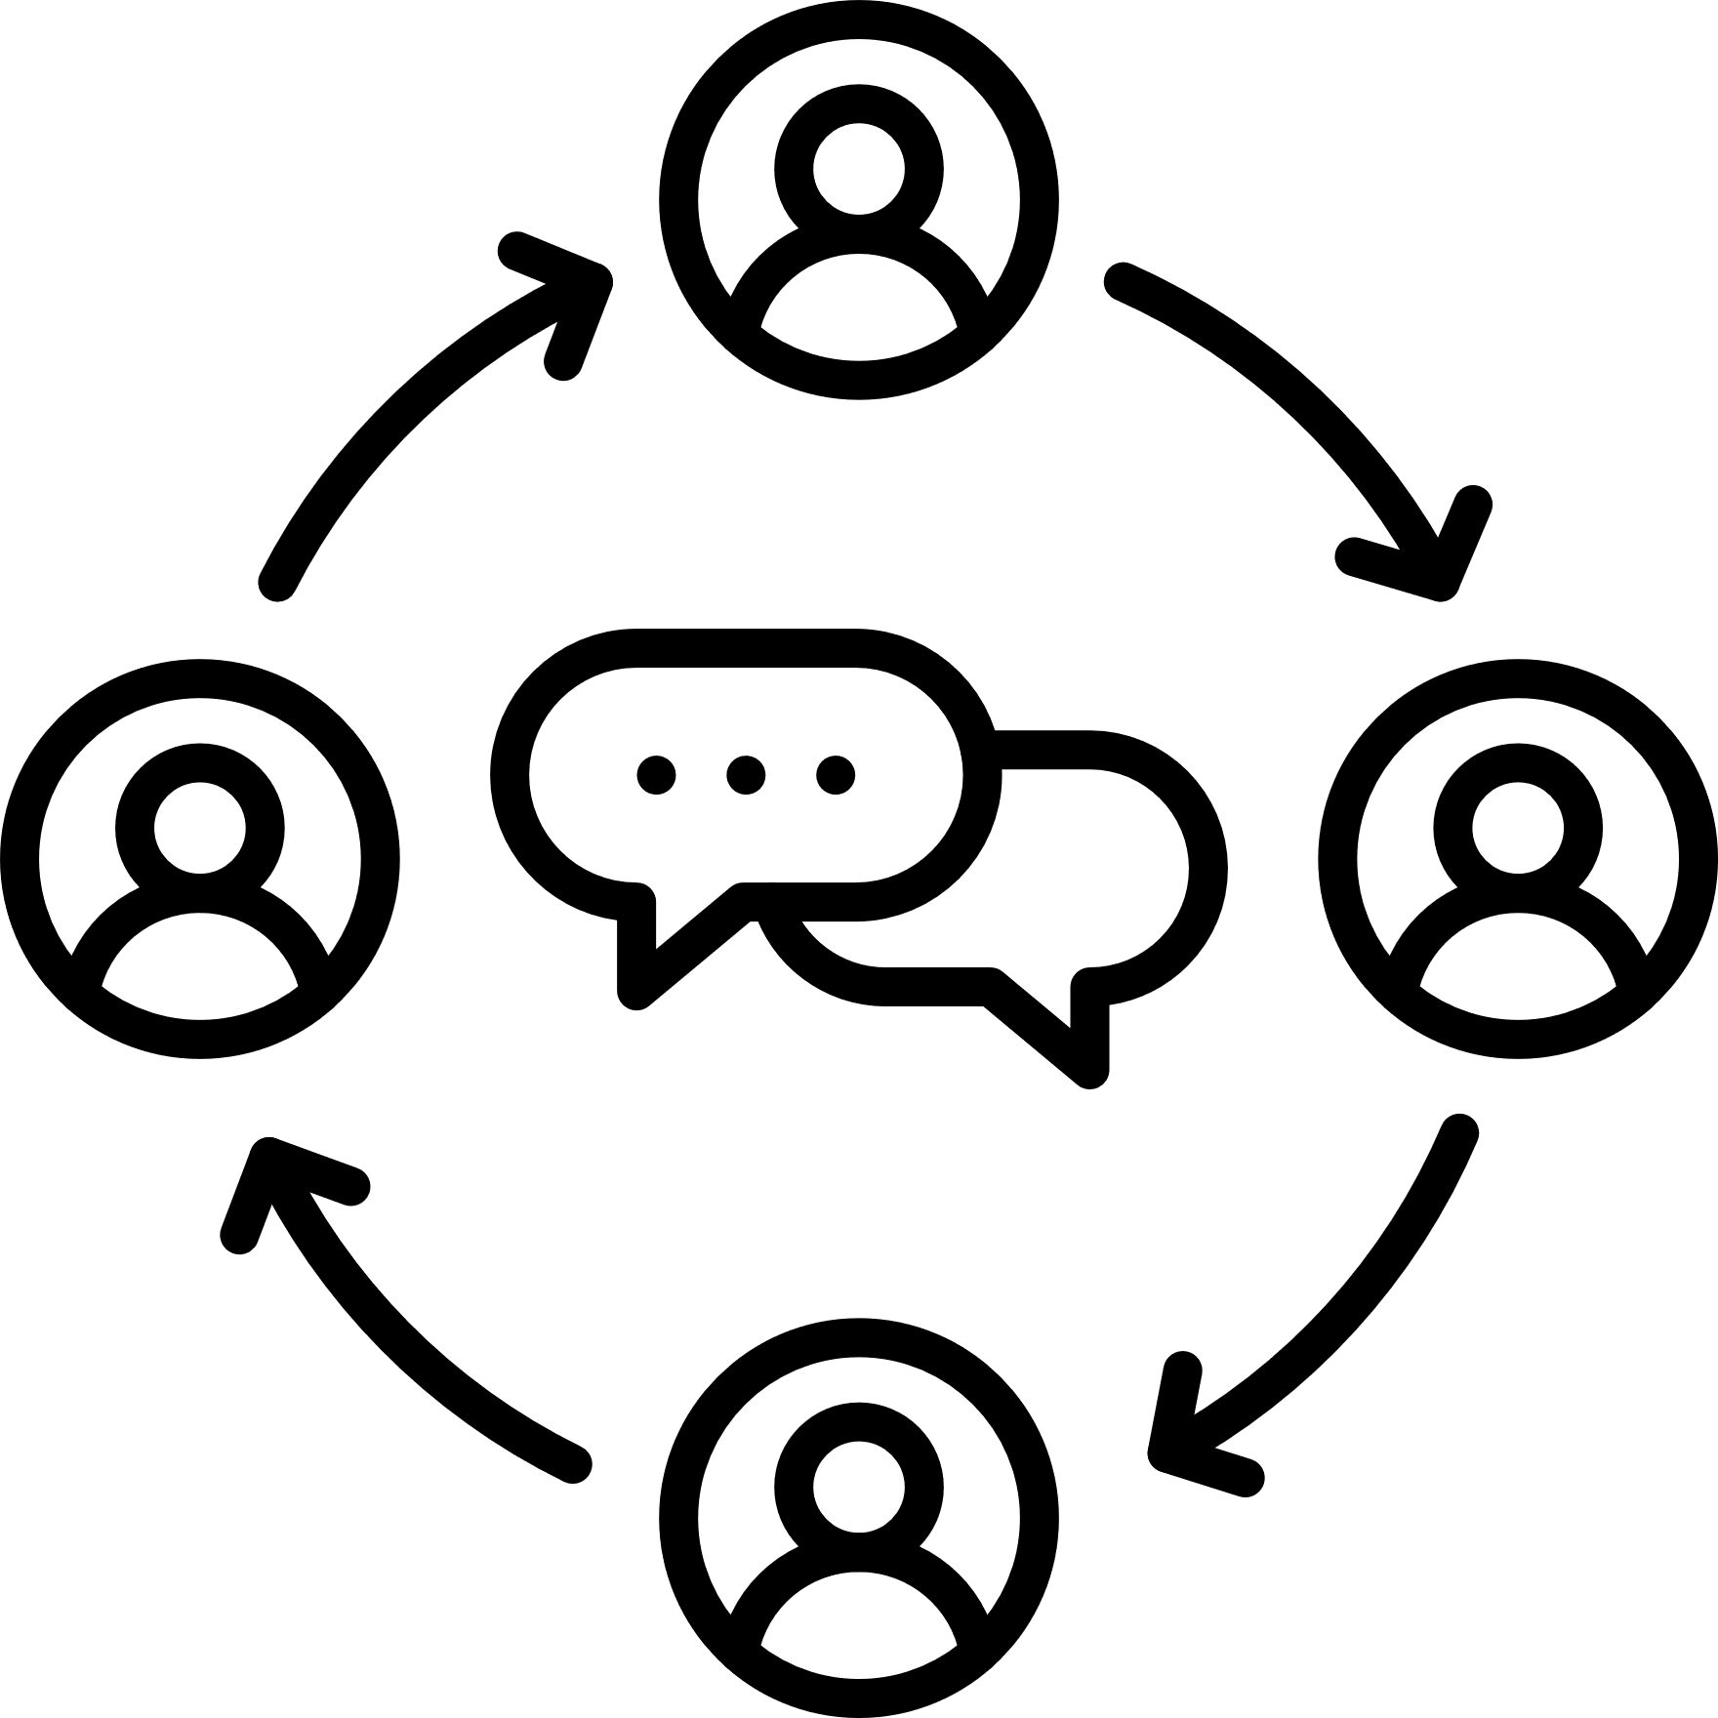





Considerations for NHS Leaders
New MPs’ Party and personal priorities​
Clear lines of communication​
Establish casework response expectations​
Political and personal dynamics​
How MPs balance local vs national priorities​
Leveraging regional investment and spotlight​
Help simplify the NHS for them

Slide 9
Table Conversation 2
  What are the difficult issues that you are dealing with locally where MPs can be good allies/challenging opposers? ​
  Think of the issue(s) you want to explore with two former MPs after lunch to glean different perspectives

Slide 10
Discussion Summary
Effective engagement with MPs can help NHS leaders secure support for local priorities. Here is some advice on building a good relationship with you MPs:
✅ Understand MPs’ Priorities: Get to know their personal and party interests to get an idea of what a successful collaboration could look like
✅ Proactive Communication: Take the initiative to keep MPs informed and share good news they can amplify.
✅ Local vs. National Balance: Engage MPs early, especially if national plans may conflict with local needs, positioning them as ambassadors for your initiatives.
✅ Leverage Regional Networks: Work with senior and devolved politicians in the region to unlock support for local projects.
✅ Demystify the NHS: Avoid jargon; simplify complex issues so MPs can better understand and support your work.

Slide 11
Groups For Conversations With
Parliamentarians​
Group | 1 | 2 | 3 | 4 | 5
Conversation 1 | Tim Loughton | Matt Warman | Steve Brine | Paul Williams | Holly Lynch
Conversation 2 | John Leech | Lia Nici | Holly Lynch | John Stevenson | Matt Warman
Group | 6 | 7 | 8 | 9
Conversation 1 | John Leech | Lia Nici | John Stevenson | Charlotte Atkins
Conversation 2 | Tim Loughton | Paul Williams | Charlotte Atkins | Steve Brine

Slide 12
Steve Brine
  Former Conservative MP for Winchester, Health Minister and Chair, Health and Care Select Committee​
  Host of Prevention is the new cure health and politics podcast

Slide 13
Discussion Summary
Today’s Power of Political Partnerships masterclass offered invaluable insights from MPs on how NHS leaders can build meaningful, proactive relationships with political figures. Here are some key takeaways:
Build relationships early – Don’t wait for a crisis. Engaging with MPs in positive circumstances creates a foundation for mutual benefit.
Do your research – Before meeting an MP, understand their political stance and priorities using publicly available information.
Use parliamentary assistants – They can advise on the best ways to contact MPs and help establish a structured communication plan.
Remember MPs are patients too – Their views are often shaped by personal experiences with the NHS.
Keep engagement simple and action-focused – Offer clear, concise information and suggestions on how they can support your work.
Keep MPs informed – They prefer to hear news—good or bad—directly from you rather than second-hand. This builds trust and transparency.
Be persistent – New MPs, in particular, can be overwhelmed, and messages may get lost. Keep reaching out. They do want to hear from NHS organisations.
Establish a key point of contact – Ensure MPs know who they can reach out to within your organisation.
Clarify your ask – MPs may not have executive power, but they can influence debates, bring stakeholders together, and communicate with the public.
Time your engagement strategically – Stay aware of political events and debates. Well-timed, evidence-based insights from NHS leaders to local politicians can shape discussions and policymaking.

Slide 14
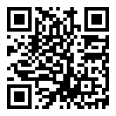
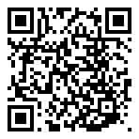
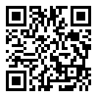

Connect With The NHS North West
Leadership Academy....
Website
Newsletter
LinkedIn
X

