Slide 1

Generational Differences Masterclass
Where there are people, there are generations
Lead42

Slide 2
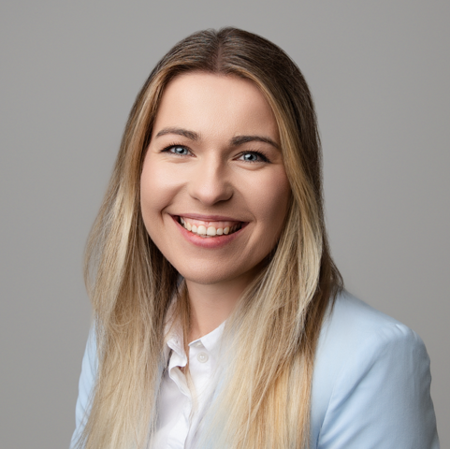
01 Unpick some of the myths and
stereotypes about generations
02 Rebuild the generational picture
informed by the evidence base
Carys Ward
Workplace and Coaching Psychologist
03 What this means for you, your leadership,
your team and your organisation

Slide 3
Introductions
What you do
What you hope to gain from today

Slide 4
Pop questions in the chat as we go

Slide 5
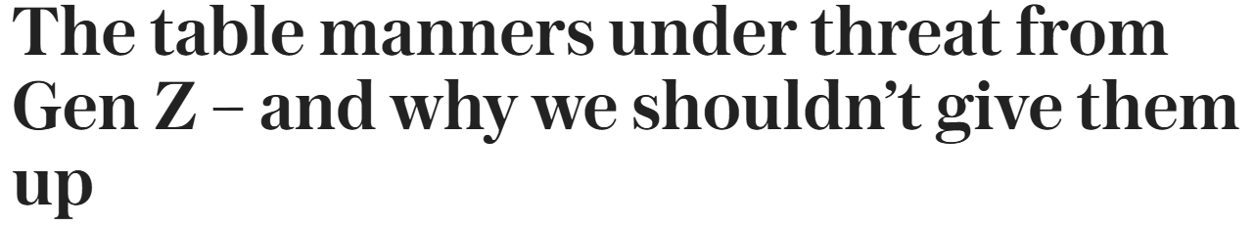
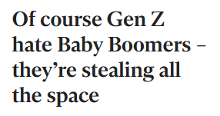
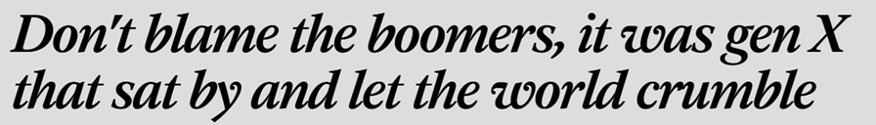
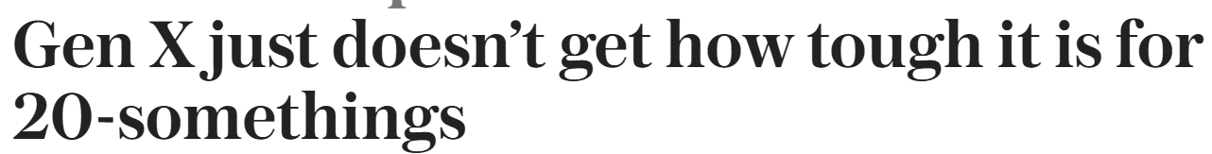
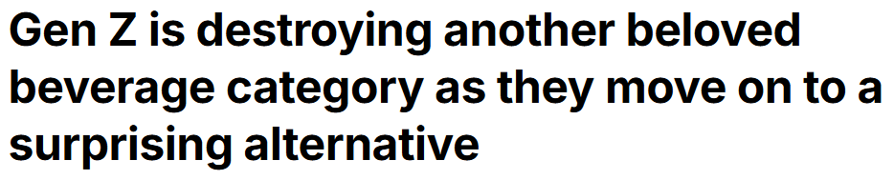
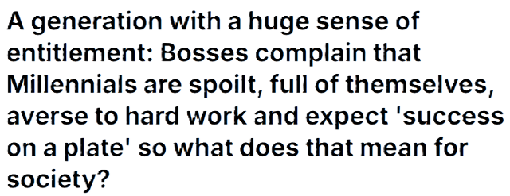

Why Generations?

Slide 6
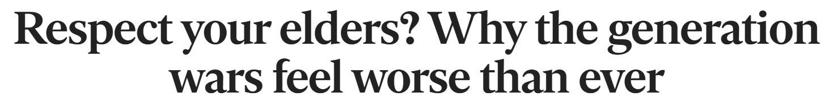
Why Generations?

Slide 7
Why Generations?
On a scale of 1-10 where would you rate your current knowledge of generational differences?

Slide 8
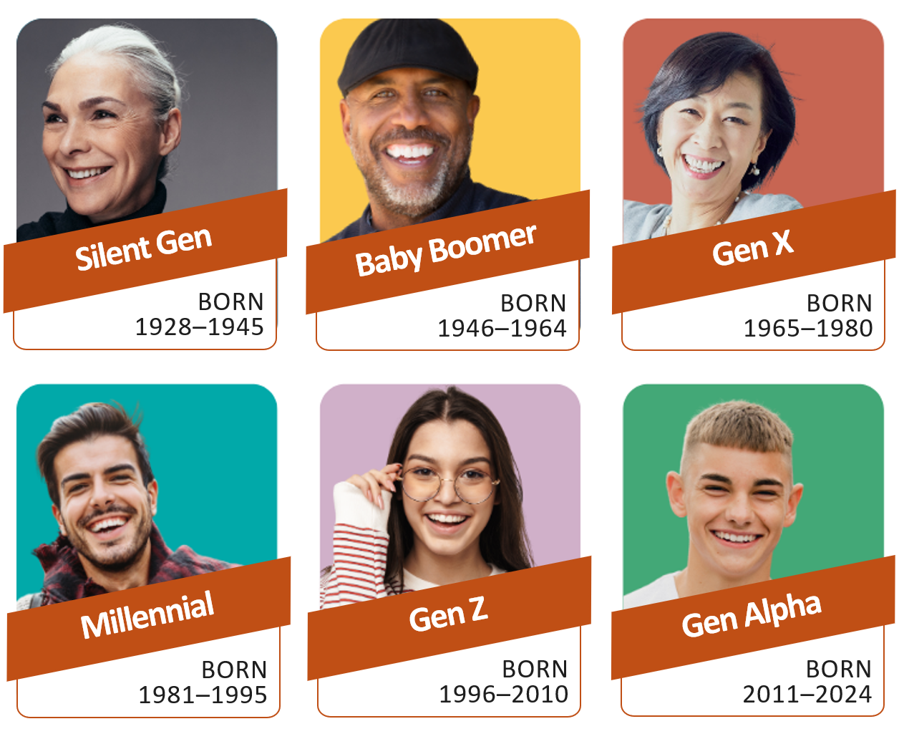
Which generation are you?

Slide 9
What marks the end of one generation and the start of the next?

Slide 10
Higher
O
R
Lower
The Generational Edition

Slide 11

Prefers formal communication

Slide 12
Desire for more purpose in work

Slide 13
Desire for frequent feedback

Slide 14
Values autonomy

Slide 15
Preference for team collaboration

Slide 16
Desire for flexible working

Slide 17
How many did you score?

Slide 18
What are your biggest generational challenges?

Slide 19



3 Most Common Challenges
Communication Barriers
Conflicting Work Habits
Lack of Understanding

Slide 20
Change resisters, overly traditional values
Rigid in work culture, don’t understand younger gens
Overly independent, disengaged and cynical
Entitled and lazy, with a lack of loyalty
Short attention, interpersonal skills lacking
Digital over-reliance, lacking real world solutions

Slide 21
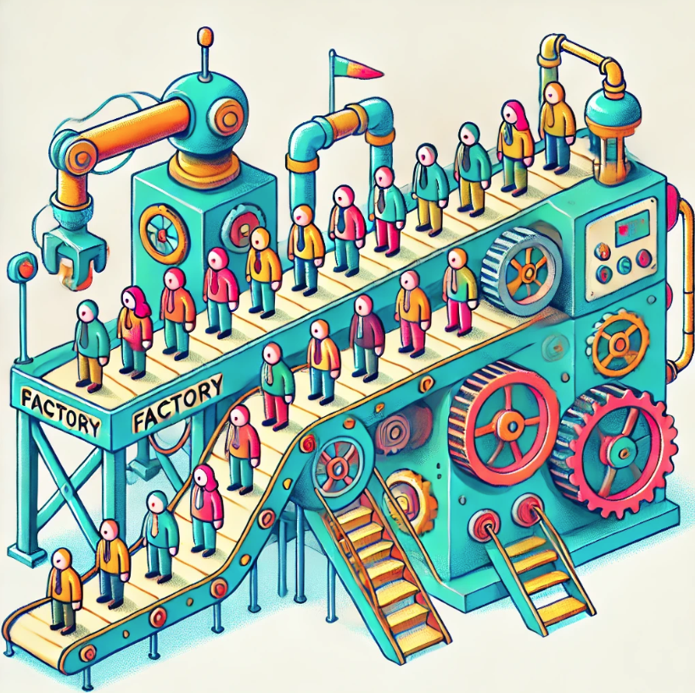

Slide 22
“I see no hope for the future of our people if they are dependent on frivolous youth of today, for certainly all youth are reckless beyond words... When I was young, we were taught to be discreet and respectful of elders, but the present youth are exceedingly disrespectful and impatient…”
Hesiod, a poet from 700 BCE. Ancient Greece in Works and Days

Slide 23
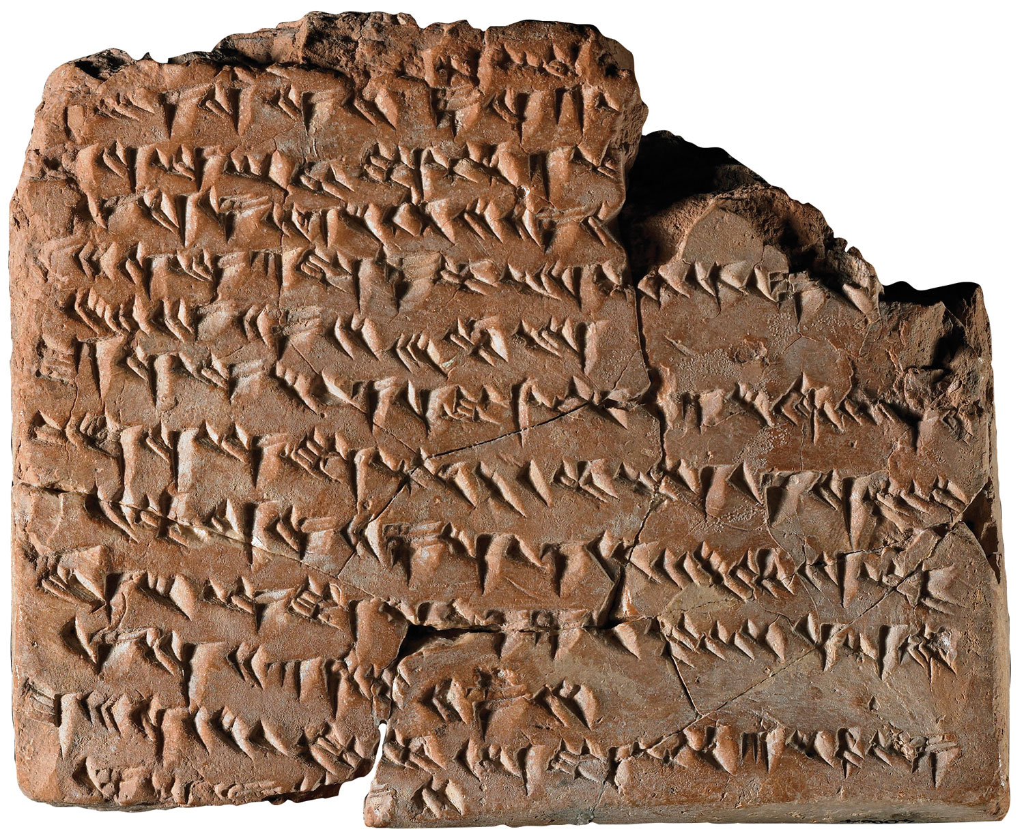
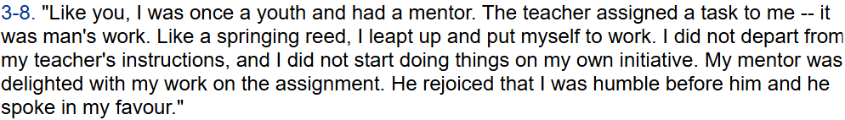
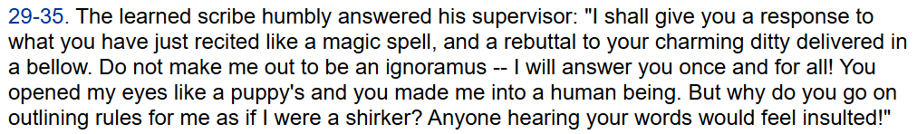
4000 years ago…
A scribe and a supervisor

Slide 24
4000 years ago…
A scribe and a supervisor
Supervisor: back in my day, I followed the rules and didn’t question authority
Scribe: thanks for the lecture, but get off my back and stop talking to me like I am a slacker

Slide 25
Men of age object too much, consult too long, adventure too little, repent too soon, and seldom drive business home…
Francis Bacon in 17th Century Essays: Of Youth and Age

Slide 26
Change resisters, overly traditional values
Rigid in work culture, don’t understand younger gens
Overly independent, disengaged and cynical
Entitled and lazy, with a lack of loyalty
Short attention, interpersonal skills lacking
Digital over-reliance, lacking real world solutions
Age + environment

Slide 27
Change resisters, overly traditional values
Rigid in work culture, don’t understand younger gens
Overly independent, disengaged and cynical
Entitled and lazy, with a lack of loyalty
Short attention, interpersonal skills lacking
Digital over-reliance, lacking real world solutions
A steady presence during change
Loyal and deeply experienced
Resilient and self-sufficient
Drive positive work culture change
Quick learners and socially conscious
Redefining innovative work

Slide 28
The Real Leadership Challenge
How do we, at an individual, team and organisational level, leverage these strengths

Slide 29

First we have to zoom out

Slide 30
What do we all need at work?

Slide 31
The Golden Principles
Autonomy
Relatedness
Competence
Autonomy
Belonging
Contribution
Autonomy
Purpose
Mastery
Ryan & Deci (2000)
West & Coia (2018)
Pink (2009)

Slide 32
But there are differences in how these principles show up
Stage of Life | Wellbeing | Motivators/Expectations
Young Adults (Gen Z) | Mental health focus Boundary setting Anxiousness around job/economic security | Stable pay Clear progression Developmental feedback
Established Stage (Millennial) | Balance under pressure (parenthood/mortgage) Flexibility to manage family | Growth and advancement Work-life balance Stability
Mid Stage (Gen X) | Sandwich stress (parenthood colliding with caring for older parents) | Autonomy linked to expertise Results over input Role clarity (stability and consistency) Pay representative of experience
Later Stage (Baby Boomer) | Flexibility tied to need Work may be tied to identity Retirement transition | Recognition for experience Role clarity (stability and consistency)

Slide 33
At an Individual Level At a Team Level

Slide 34
At an Individual Level At a Team Level

Slide 35
Given what we now know, the best question to ask is: where is this person in their career and life and, given this, how can I support them to bring their best to work?

Slide 36
‘Having one meaningful conversation per week with each team member develops high-performance relationships more than any other leadership activity’
Gallup ⁽²⁰²⁴⁾

Slide 37
How we lead 1-2-1s
Typically we ask:
What have you got on?
What are you stuck with?
What do you need from me?
Questions we can now ask:
What was a great moment or achievement from the past week?
When you have a great day at work, what does it look like?
Is there a strength you have that you think is currently underused?
What development are you looking for?
Are there things you want to do more of?
Is there anything weighing on you that is making work harder right now?
What is one thing I could do differently as your leader?

Slide 38
At an Individual Level At a Team Level

Slide 39
Change resisters, overly traditional values
Rigid in work culture, don’t understand younger gens
Overly independent, disengaged and cynical
Entitled and lazy, with a lack of loyalty
Short attention, interpersonal skills lacking
Digital over-reliance, lacking real world solutions

Slide 40
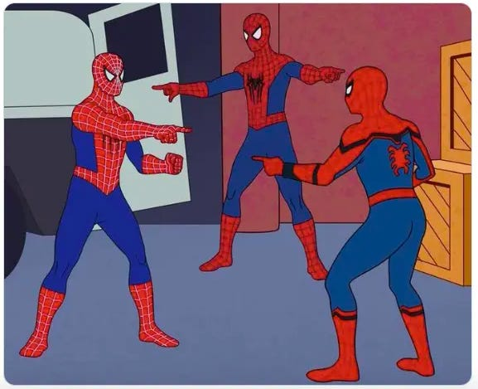

Slide 41
Change resisters, overly traditional values
Rigid in work culture, don’t understand younger gens
Overly independent, disengaged and cynical
Entitled and lazy, with a lack of loyalty
Short attention, interpersonal skills lacking
Digital over-reliance, lacking real world solutions
A steady presence during change
Loyal and deeply experienced
Resilient and self-sufficient
Drive positive work culture change
Quick learners and socially conscious
Redefining innovative work

Slide 42
Three Quick Wins
Beyond the Lanyard: getting to know each other beyond the job title (belonging)
Understanding Strengths: knowing how to help someone bring their best to work and sharing what I need
Clear Shared Vision: your team ‘why’ is clear and understood by all (contribution)

Slide 43
Aims
01
Unpick some of the myths and stereotypes about generations
02
Rebuild the generational picture informed by the evidence base
03
What this means for you, your leadership, your team and your organisation

Slide 44
Generational differences have always existed
Generations are characterised by age and environment (rather than being a personality type)
Each generation brings strengths
Each generation has needs to be met to thrive at work
The key for leaders is to:
    Know your team as individuals
    Focus on leveraging strengths
    Support others to navigate generational differences

Slide 45
What has resonated?
What’s One Thing you’ll do off the back of today’s session?

